Slide 1
Crafting Real-time Mobile Apps with Xamarin & SignalR
Presenter Name
Title
@TwitterHandle

Slide 2







.NET: Your platform for building anything
Desktop
Web
Cloud
Mobile
Gaming
IoT
AI
.NET
Notes:
As developers we need to be able to reach every platform on the planet. And that is the goal of .NET enabling developers to build for these devices with unique frameworks optimized for each.
Today, we will look at what the Xamarin platform and framework, which are part of .NET offer.

Slide 3
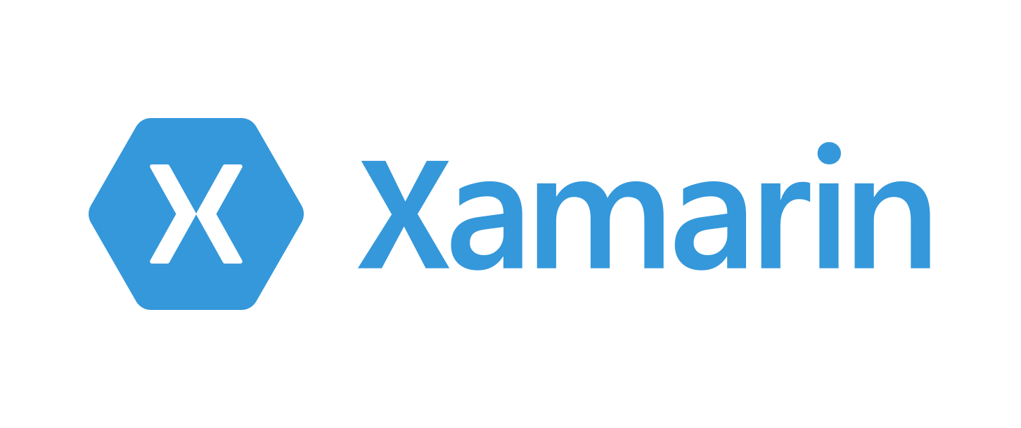

Slide 4
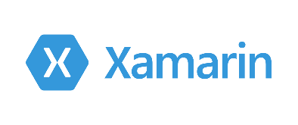
An open source app platform
from Microsoft for
building modern & performant
iOS, Android, macOS,
watchOS, & tvOS apps with .NET.

Slide 5
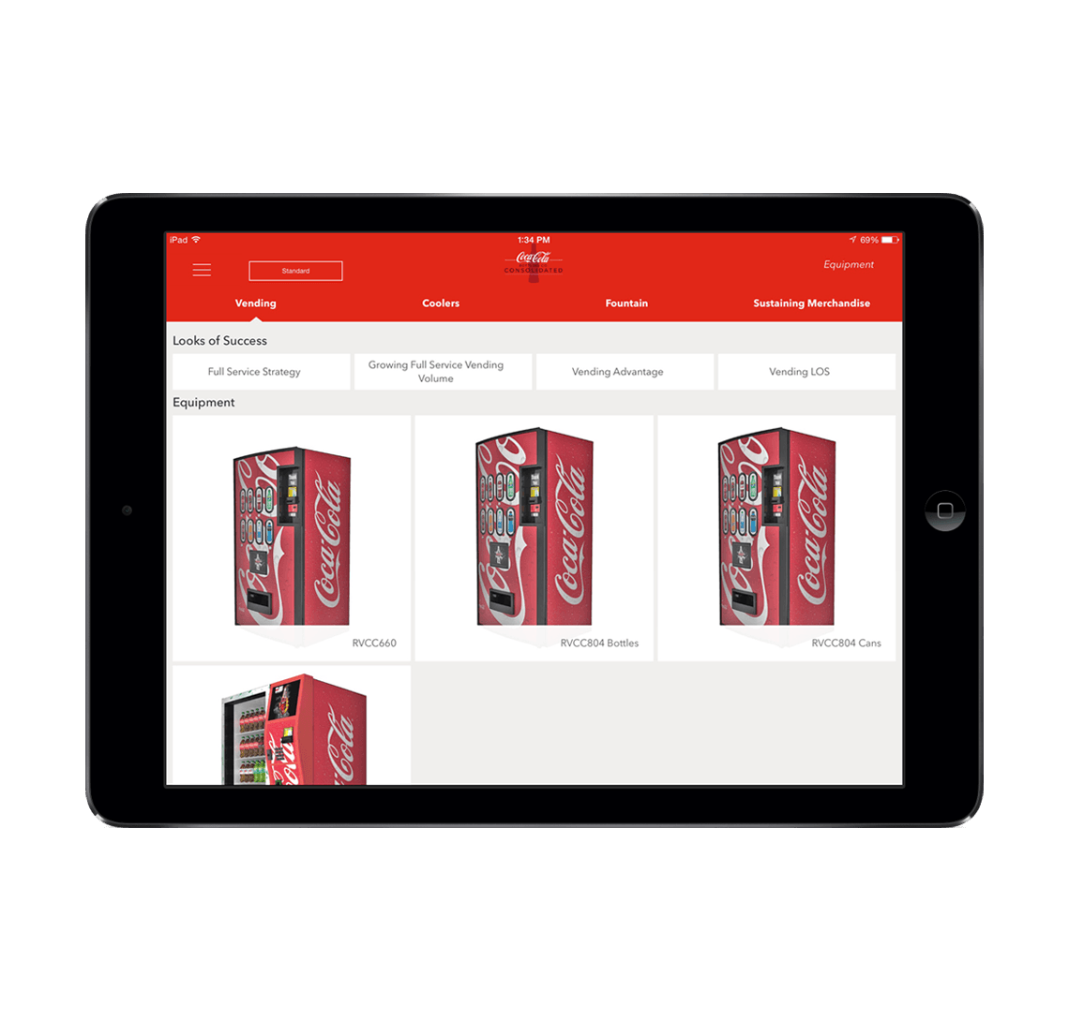
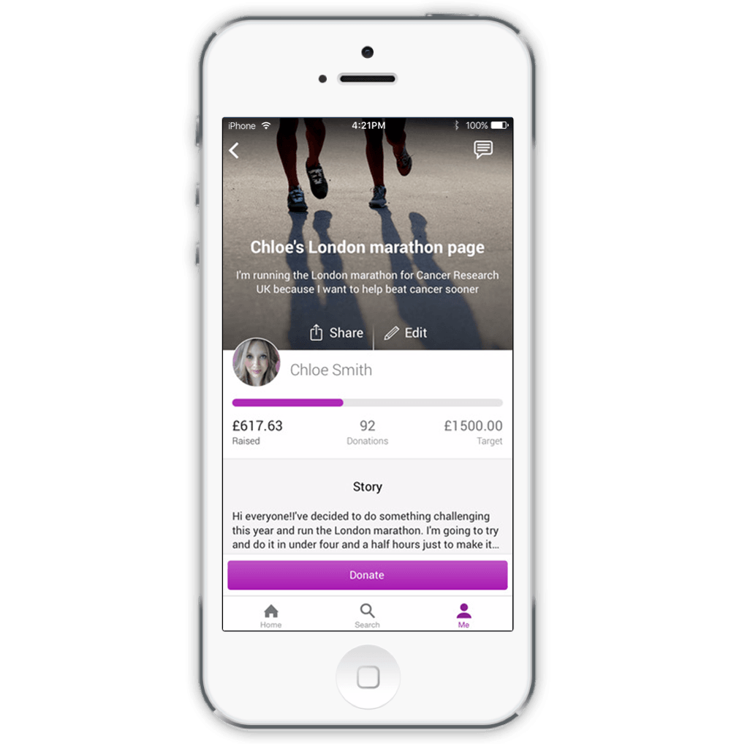
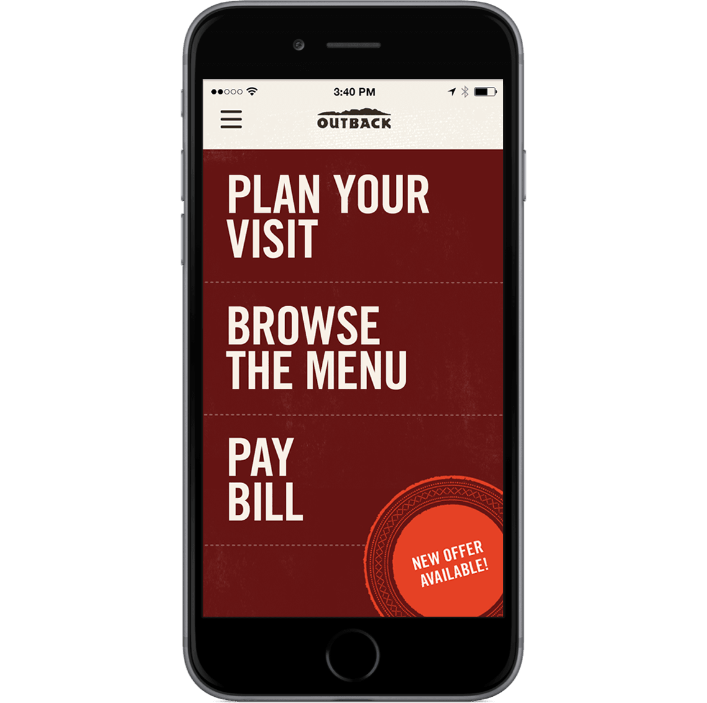

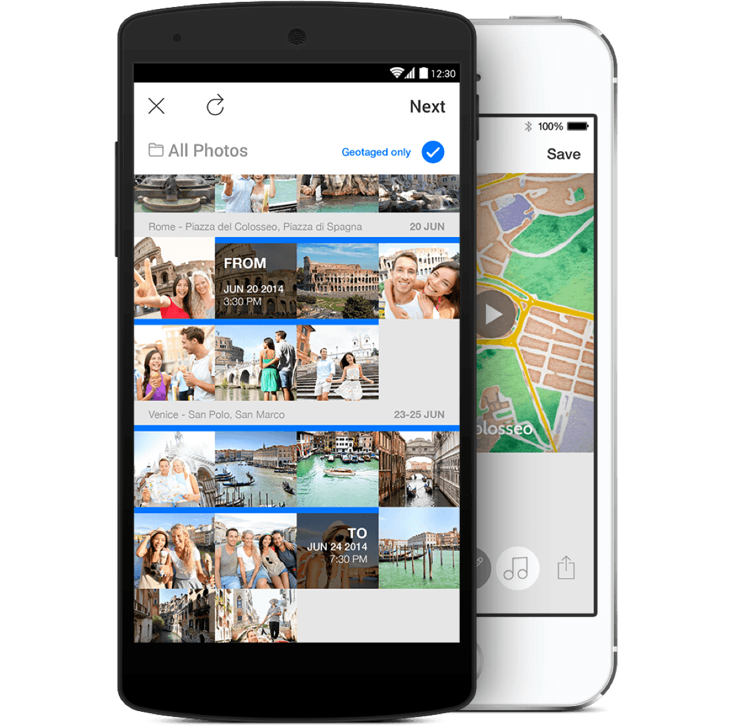
Xamarin App Architecture
.NET
C#
C#
C#
Shared C#
Business Logic • Platform APIs • User Interface
Notes:
First is the core architecture which enables huge amount of code sharing across apps. You can build stunning applications with high fidelity. Let’s talk about what is in each of these blocks, first with the head projects, platform APIs, and user interface. The business logic is just .NET code that can always be shared with other .NET platforms.

Slide 6
Windows APIs
Windows.Media
Windows.Networking
Windows.Storage
Windows.Foundation
Windows.Devices
System.Net
System
System.IO
System.Linq
System.Xml
System.Data
System.Windows
System.Numerics
System.Core
System.ServiceModel
C#
Notes:
With .NET and Window development we always had the .NET Framework which offers tons of APIs for developers to use. When you want to target desktop or web, you download a SDK and get platform APIs.

Slide 7
Xamarin.iOS
MapKit
UIKit
SiriKit
ARKit
CoreML
System.Net
System
System.IO
System.Linq
System.Xml
System.Data
System.Windows
System.Numerics
System.Core
System.ServiceModel
C#
Notes:
What the Xamarin platform does for iOS, Android, macOS, watchOS, and tvOS is bring .NET directly to them and the platform delivers “C# bindings” around the native APIs. So you have access to everything, directly in C#.
Here we see just a few of the thousands of APIs available for iOS

Slide 8
Xamarin.Android
Fingerprint
Bluetooth
Picture-in-Picture
Geolocation
NFC
System.Net
System
System.IO
System.Linq
System.Xml
System.Data
System.Windows
System.Numerics
System.Core
System.ServiceModel
C#
Notes:
The same is true for Android with thousands of APIs beyond these. In addition, the Xamarin platform delivers essential integrations which we will talk about such as Google Play services and the support libraries.

Slide 9

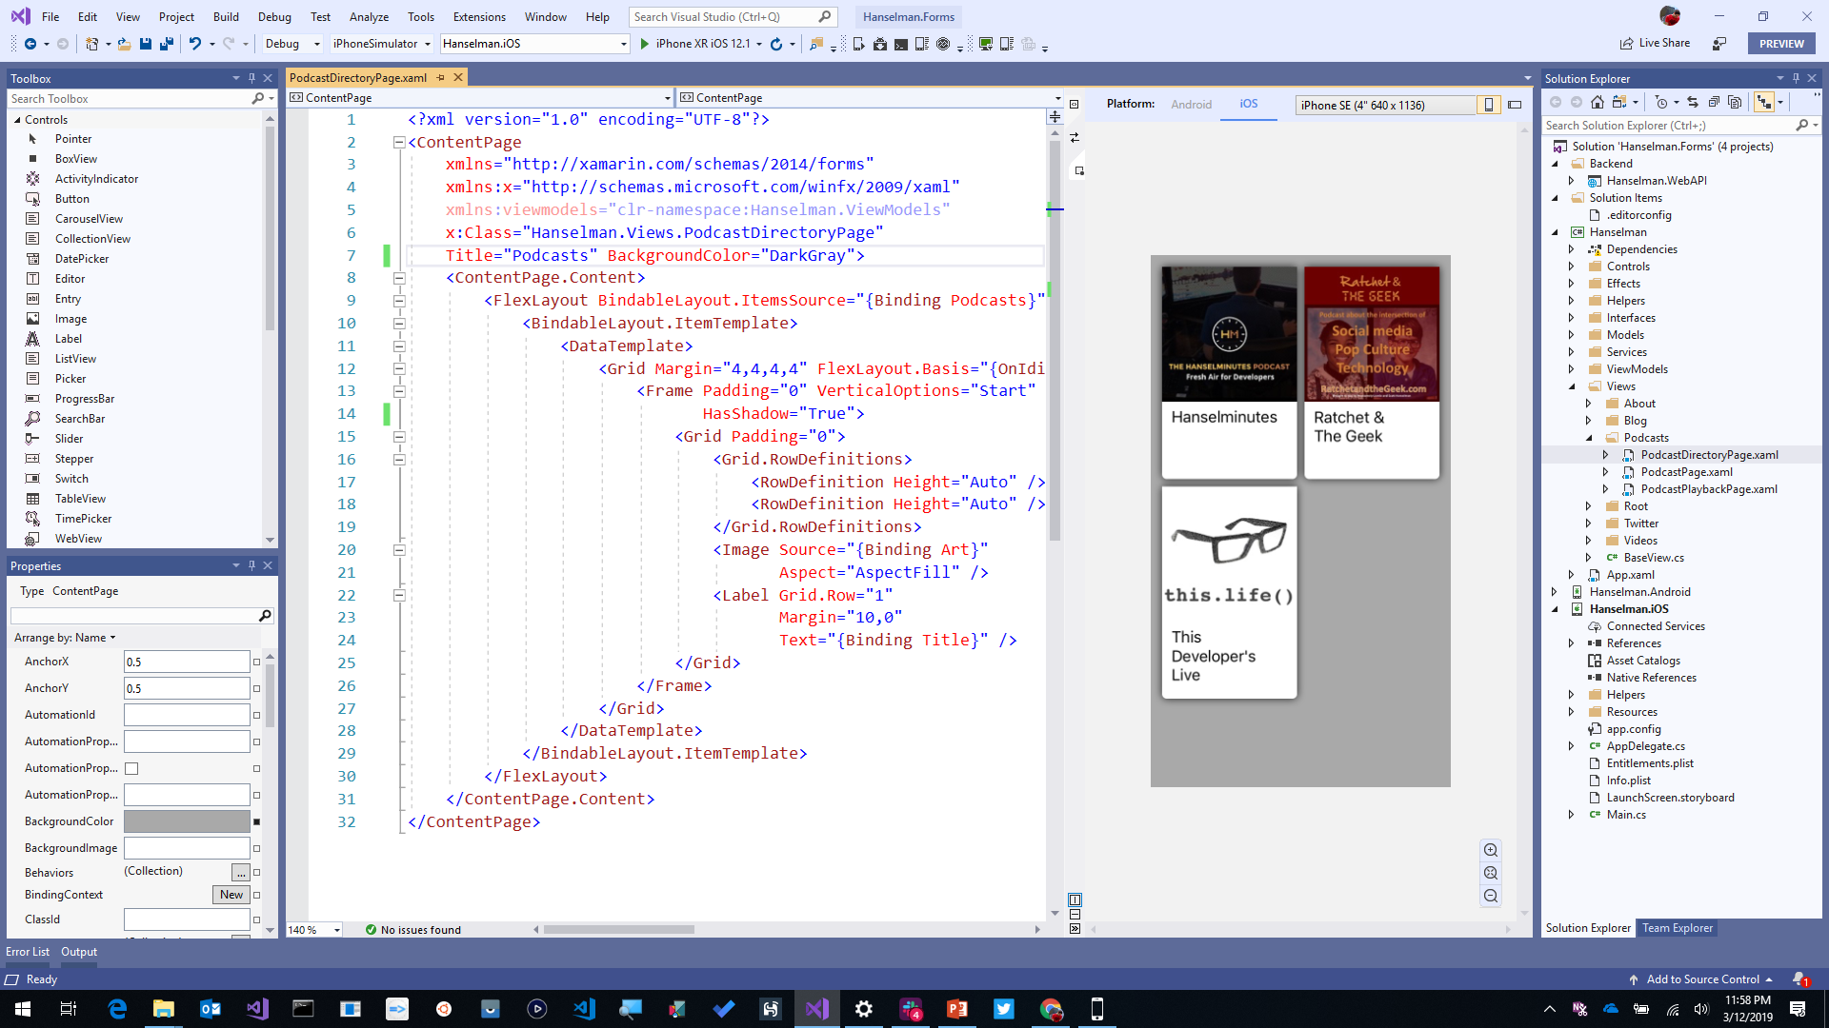
Visual Studio 2019
iOS, Android, Desktop, Web, Cloud, and More!
Advanced IntelliSense & Code Cleanup
Enhanced Collaboration with Live Share and Pull Request Experience
Advanced Debugger & Search Windows
Simple Connected Services to Deploy to Azure
Notes:
All of this work can be done in an astonishing IDE, Visual Studio! You can harness the complete power of this IDE and all of it’s amazing Intellisense, code cleanup, and extensions, and build iOS and Android apps directly on your Windows PC.

Slide 10

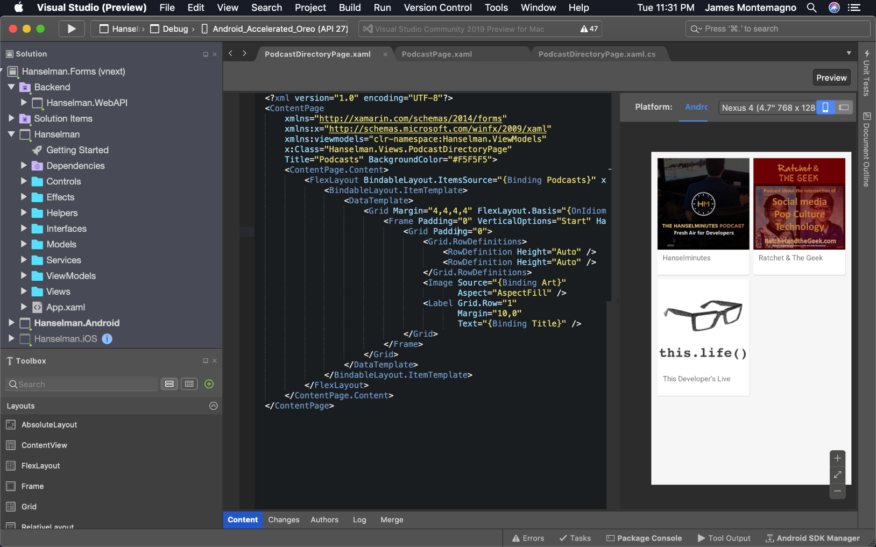
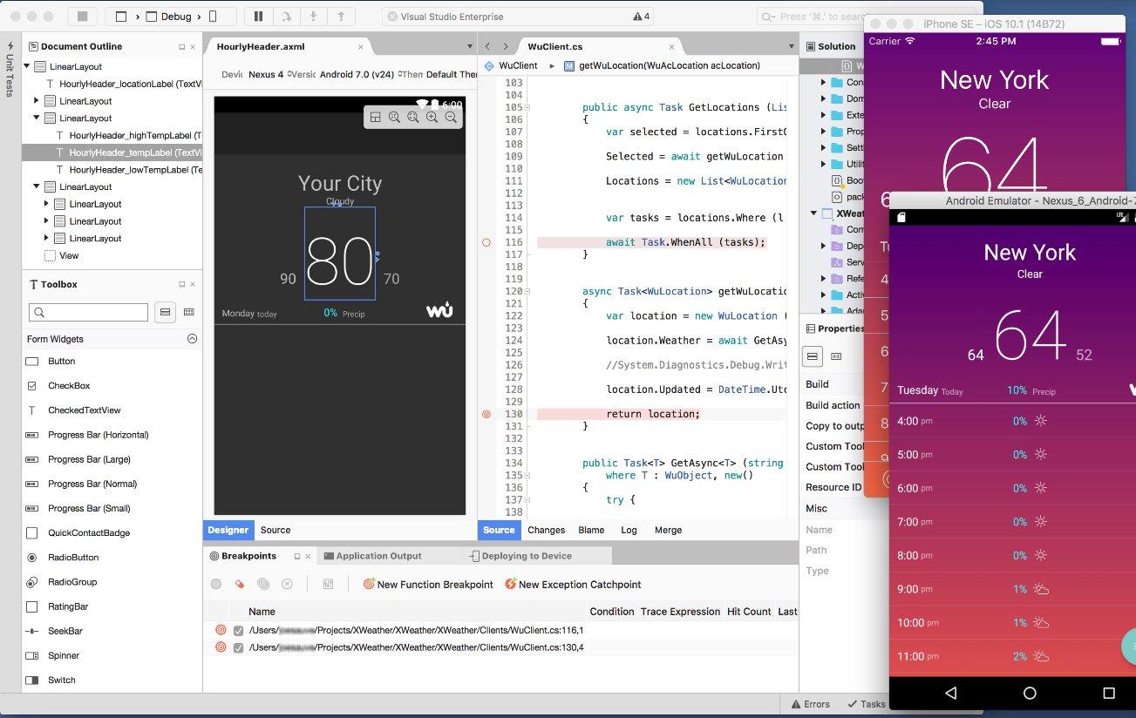
Visual Studio 2019 for Mac
.NET Centric
Focused on .NET Developers
.NET Core
ASP.NET Core Web Apps & APIs
Unity
Develop and Debug Unity Game Code
Xamarin
Mobile: Android, iOS, watchOS
macOS, tvOS
Azure
Connected Services
Easy Deployment
Azure Functions
Notes:
Best of all there is Visual Studio for Mac, bringing many workloads from Windows directly to macOS. The same projects and same solutions open.

Slide 11

Xamarin.Essentials
Secure Settings
Sms
Preferences
Flashlight
Clipboard
Gyroscope
Magnetometer
Geolocation
Phone Dialer
Device Display Info
Email
Device Info
Battery
Compass
Accelerometer
Screen Lock
Data Transfer
Text to Speech
Geocoding
File System
Connectivity
Vibration
aka.ms/xamarinessentials
Notes:
In addition to the native APIs, Xamarin also includes Xamarin.Essentials. An open source library that abstracts common native features into a single cross platform API for iOS, Android, and Windows. These are APIs that exist across each platform so why not bring them together.

Slide 12
Xamarin.Essentials: Cross-Platform Native APIs
.NET
C#
C#
C#
Xamarin.Essentials
Shared C#
Business Logic • User Interface
Notes:
So now, if we look a bit further, this is what our app architecture looks like.

Slide 13

Xamarin.Forms
Notes:
What about the user interface? Just like APIs you can build the native UI for each platform. However, many developers choose to share all or most of the UI with Xamarin.Forms

Slide 14
Xamarin.Forms: Cross-Platform Native UI
.NET
C#
C#
C#
Xamarin.Forms - UI
Xamarin.Essentials
Shared C#
Business Logic
Notes:
We will look more at Xamarin.Forms, but now we can see a full picture of what goes into our app.

Slide 15

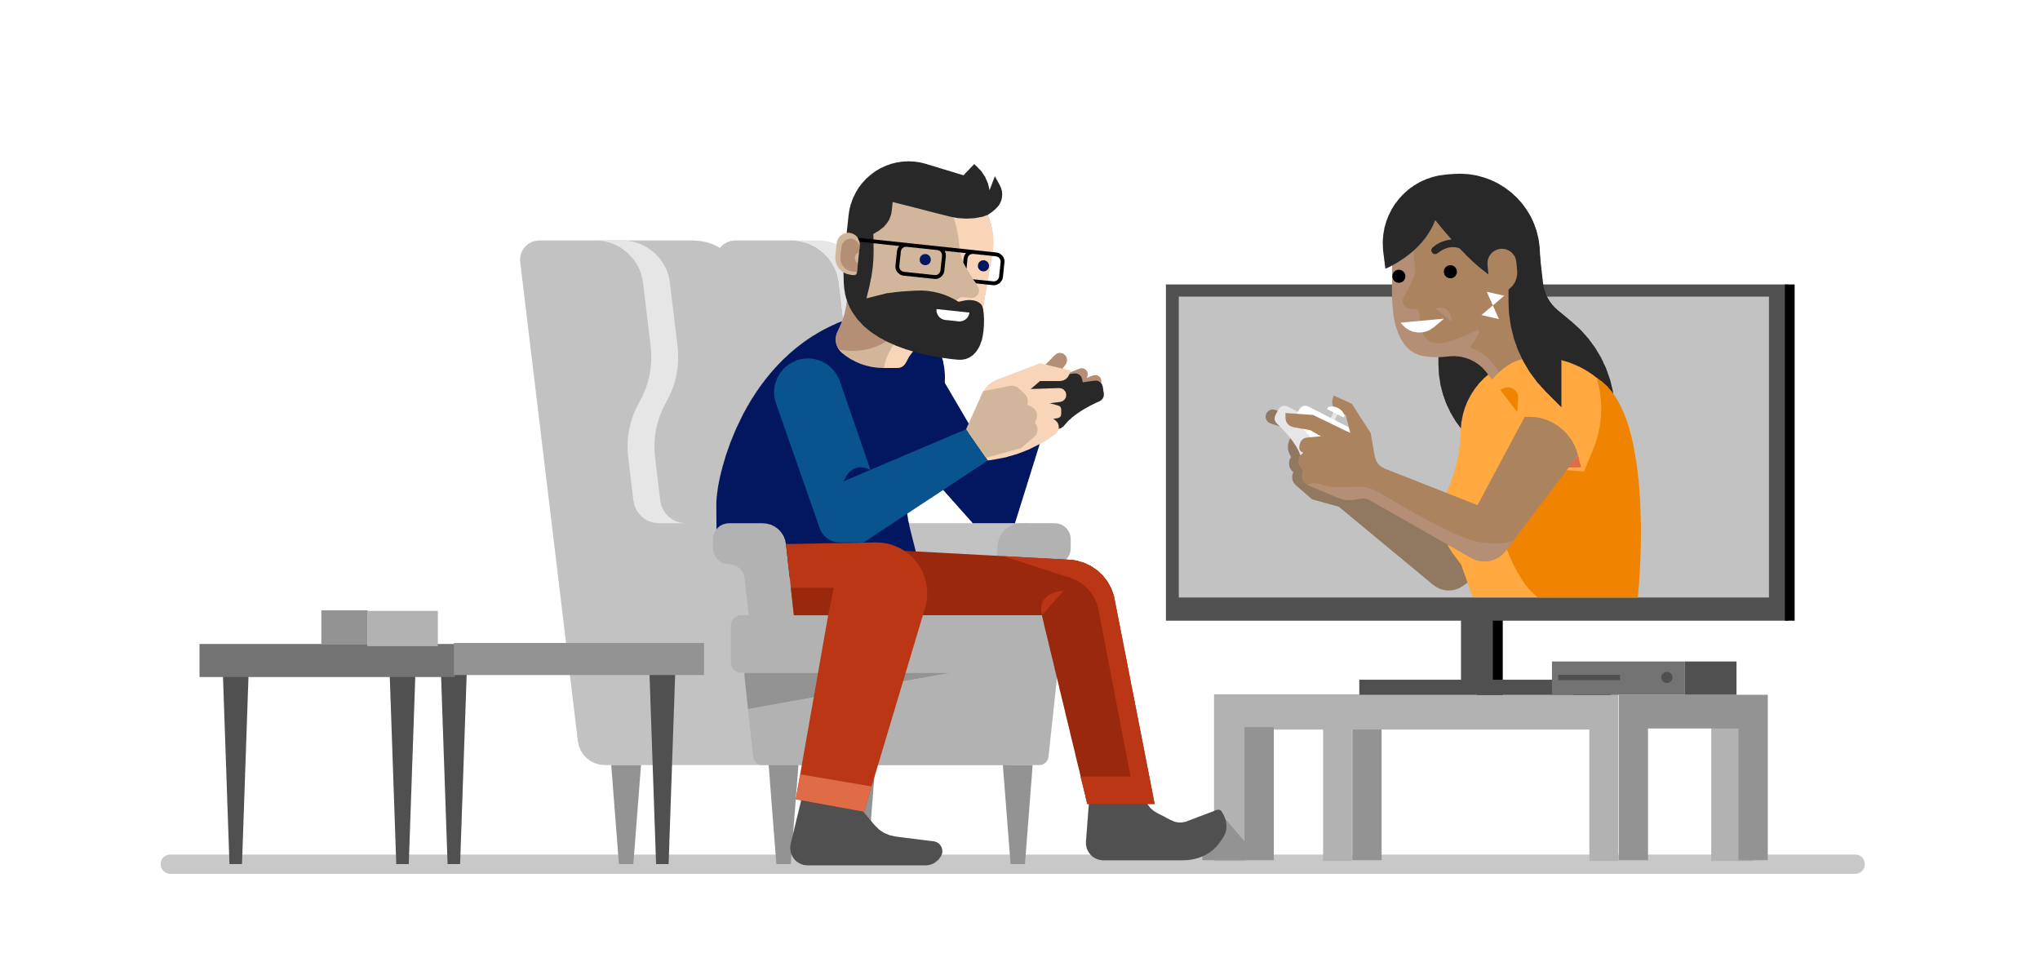

Real-time Apps
Notes:
Let’s talk about real-time applications and how to build there. There are many scenarios today from chat, gaming, and other connected devices and there are times when you and your users and communication to happen in real-time.

Slide 16
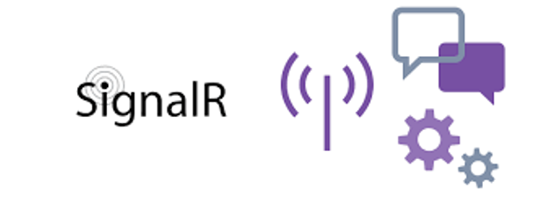
Notes:
That is where SignalR comes in to help developers build real-time applications.

Slide 17

















WebSocket
Server-sent events
Long-polling
Notes:
SignalR handles all real-time communication to any device using a series of different methods including WebSocket, Server-sent events, and long-polling. The great thing here is that you don’t have to worry about it, you just write code and SignalR handles it all for you.

Slide 18
Notes:
There are many different scenarios that SignalR can cover. Let’s say you have all hundreds of devices that you need to send messages to. Here are a few different ways you could send a message.

Slide 19




Broadcast
Notes:
First SignalR could simply broadcast a message to all devices that are connected.

Slide 20
GroupName = Seattle
Group of users
Notes:
You could segment the devices and only send a message to a “group” based on a unique name.

Slide 21
UserId = Anthony
Single user
Notes:
Or, you have the ability to send a message to a single user based on it’s id that is generated automatically for you.

Slide 22


Broadcast from server
HUB
Notes:
It works a little bit like this:
You have a “SignalR Hub” that handles all of the communication. And if could decide to send out a message to all connected to devices.

Slide 23
Broadcast from a device
Send Message
HUB
Notes:
Or, you may have one of the devices send a message to the Hub and then the Hub relays this to all connected devices.

Slide 24
Features:
Handles connection management automatically.
Sends messages to all connected clients simultaneously.
Sends messages to specific clients or groups of clients.
Scales to handle increasing traffic.

Slide 25

SignalR SDK
Notes:
On the backend you can leverage SignalR self hosted via ASP.NET Core and C# or a Azure service that I will talk more about later.
On the client side you can integrate it into any C#/.NET app including Xamarin, Web app with (JS or TS), or java app.

Slide 26
SignalR + Xamarin
https://github.com/jamesmontemagno/app-SimpleSignalR
Notes:
Let’s build a quick application that sends out message to all clients when a new item is added in the backend.

Slide 27
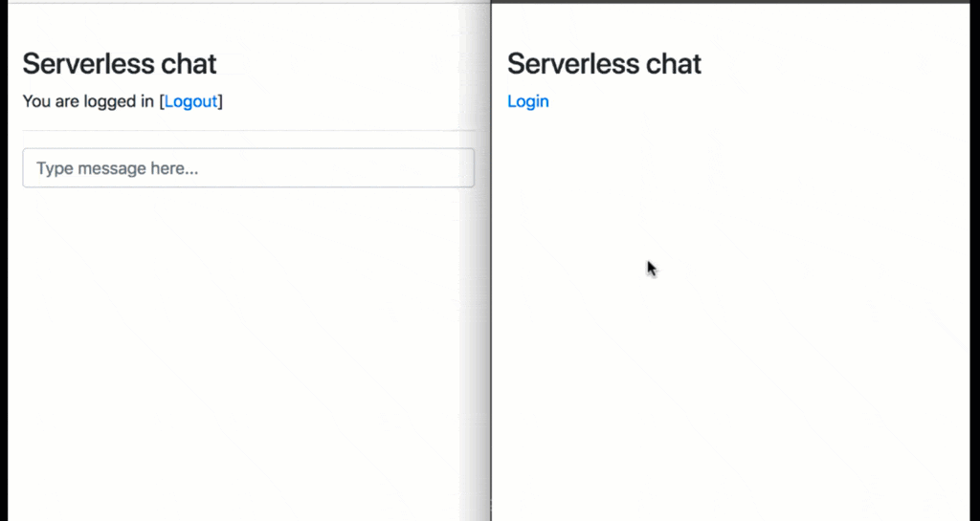
Notes:
There are many scenarios and apps built with SignalR like chat apps. Here we have an app that can broadcast to everyone or individual users.

Slide 28

Notes:
Collaborative whiteboard drawing apps

Slide 29
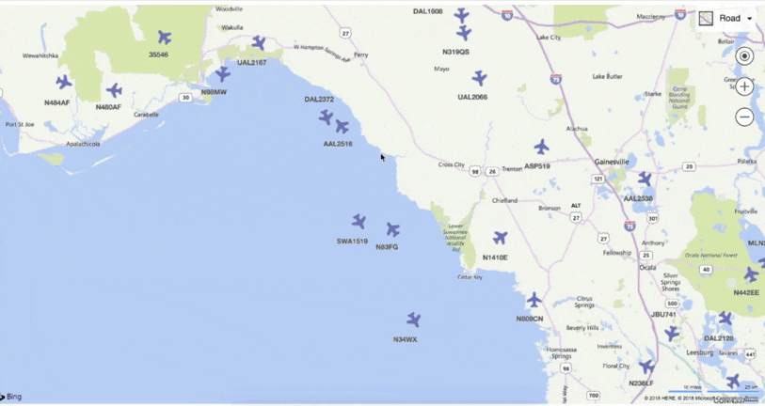
Notes:
Flight data playback

Slide 30
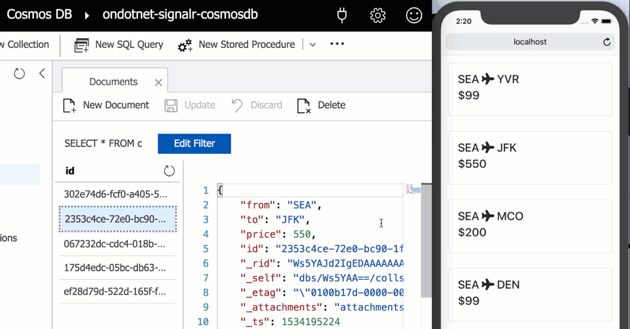
Notes:
Changes in data like a change in CosmosDB

Slide 31
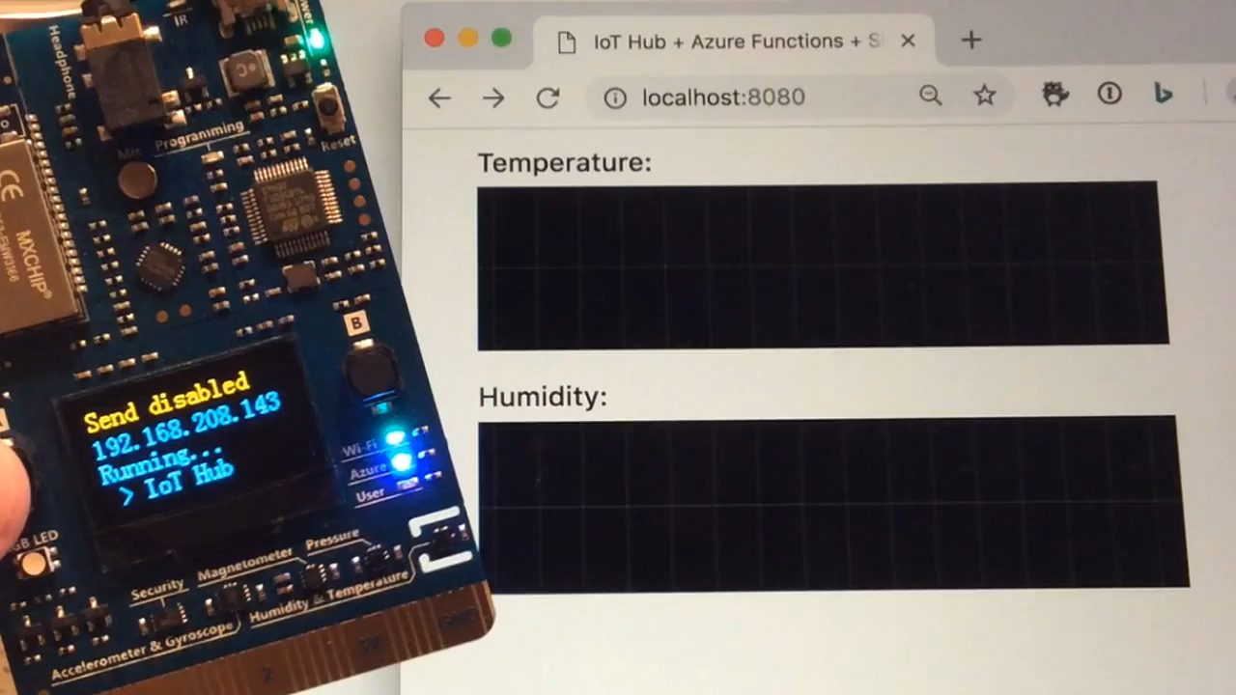
Notes:
IoT scenarios

Slide 32
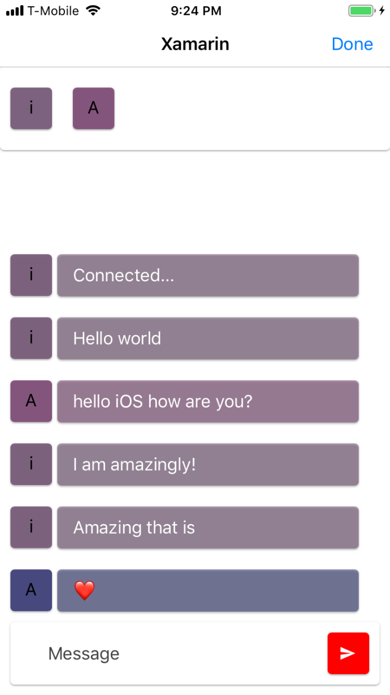
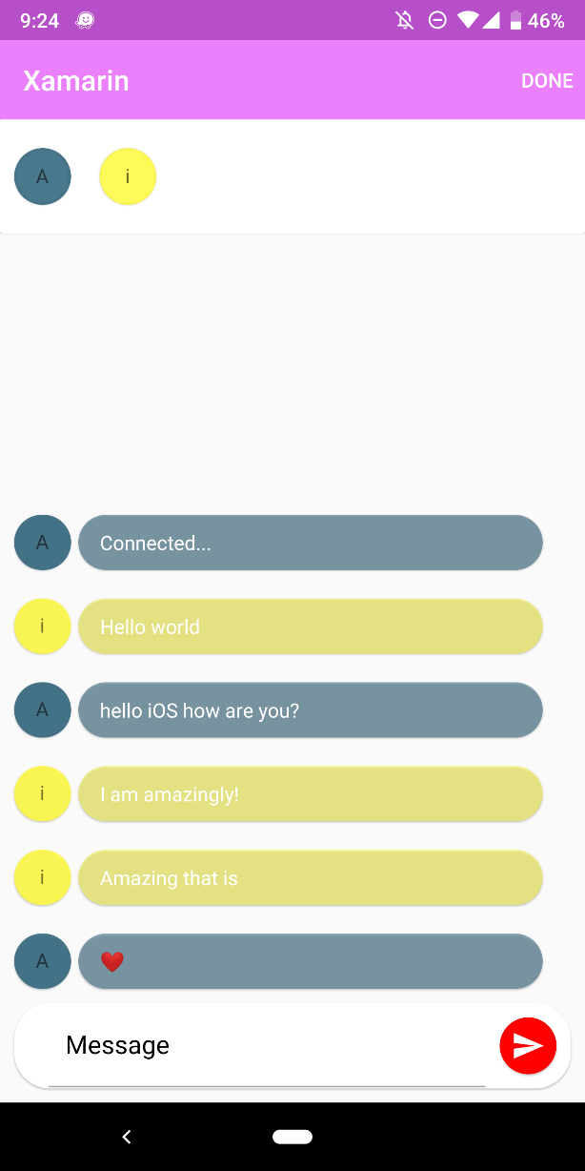
XamChat!
https://github.com/jamesmontemagno/XamChat
Notes:
Let’s build one of these with Xamarin and walk through a chat application

Slide 33

Self Hosted or Azure SignalR Service
Notes:
I mentioned earlier about the backends with ASP.NET Core or Azure SignalR service… well what is Azure SignalR Service and why would you want to use it? Well mostly because of scale!

Slide 34
100,000
concurrent connections
per instance
Notes:
Azure SignalR Service can handle up to 100,000 concurrent connections! Which is very impressive and it handles it all for you.

Slide 35
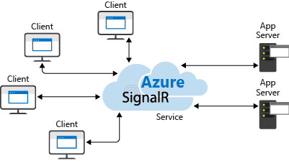
Notes:
Your app server or app directly talks to the SignalR Serivce and it handles the rest.

Slide 36

Notes:
What works great is that this plays very nice with Azure Functions to handle the bridge between all of the clients and Azure SignalR so you don’t have to have a server running.

Slide 37
Notes:
This means you can program in many languages on the backend and on the front end.

Slide 38
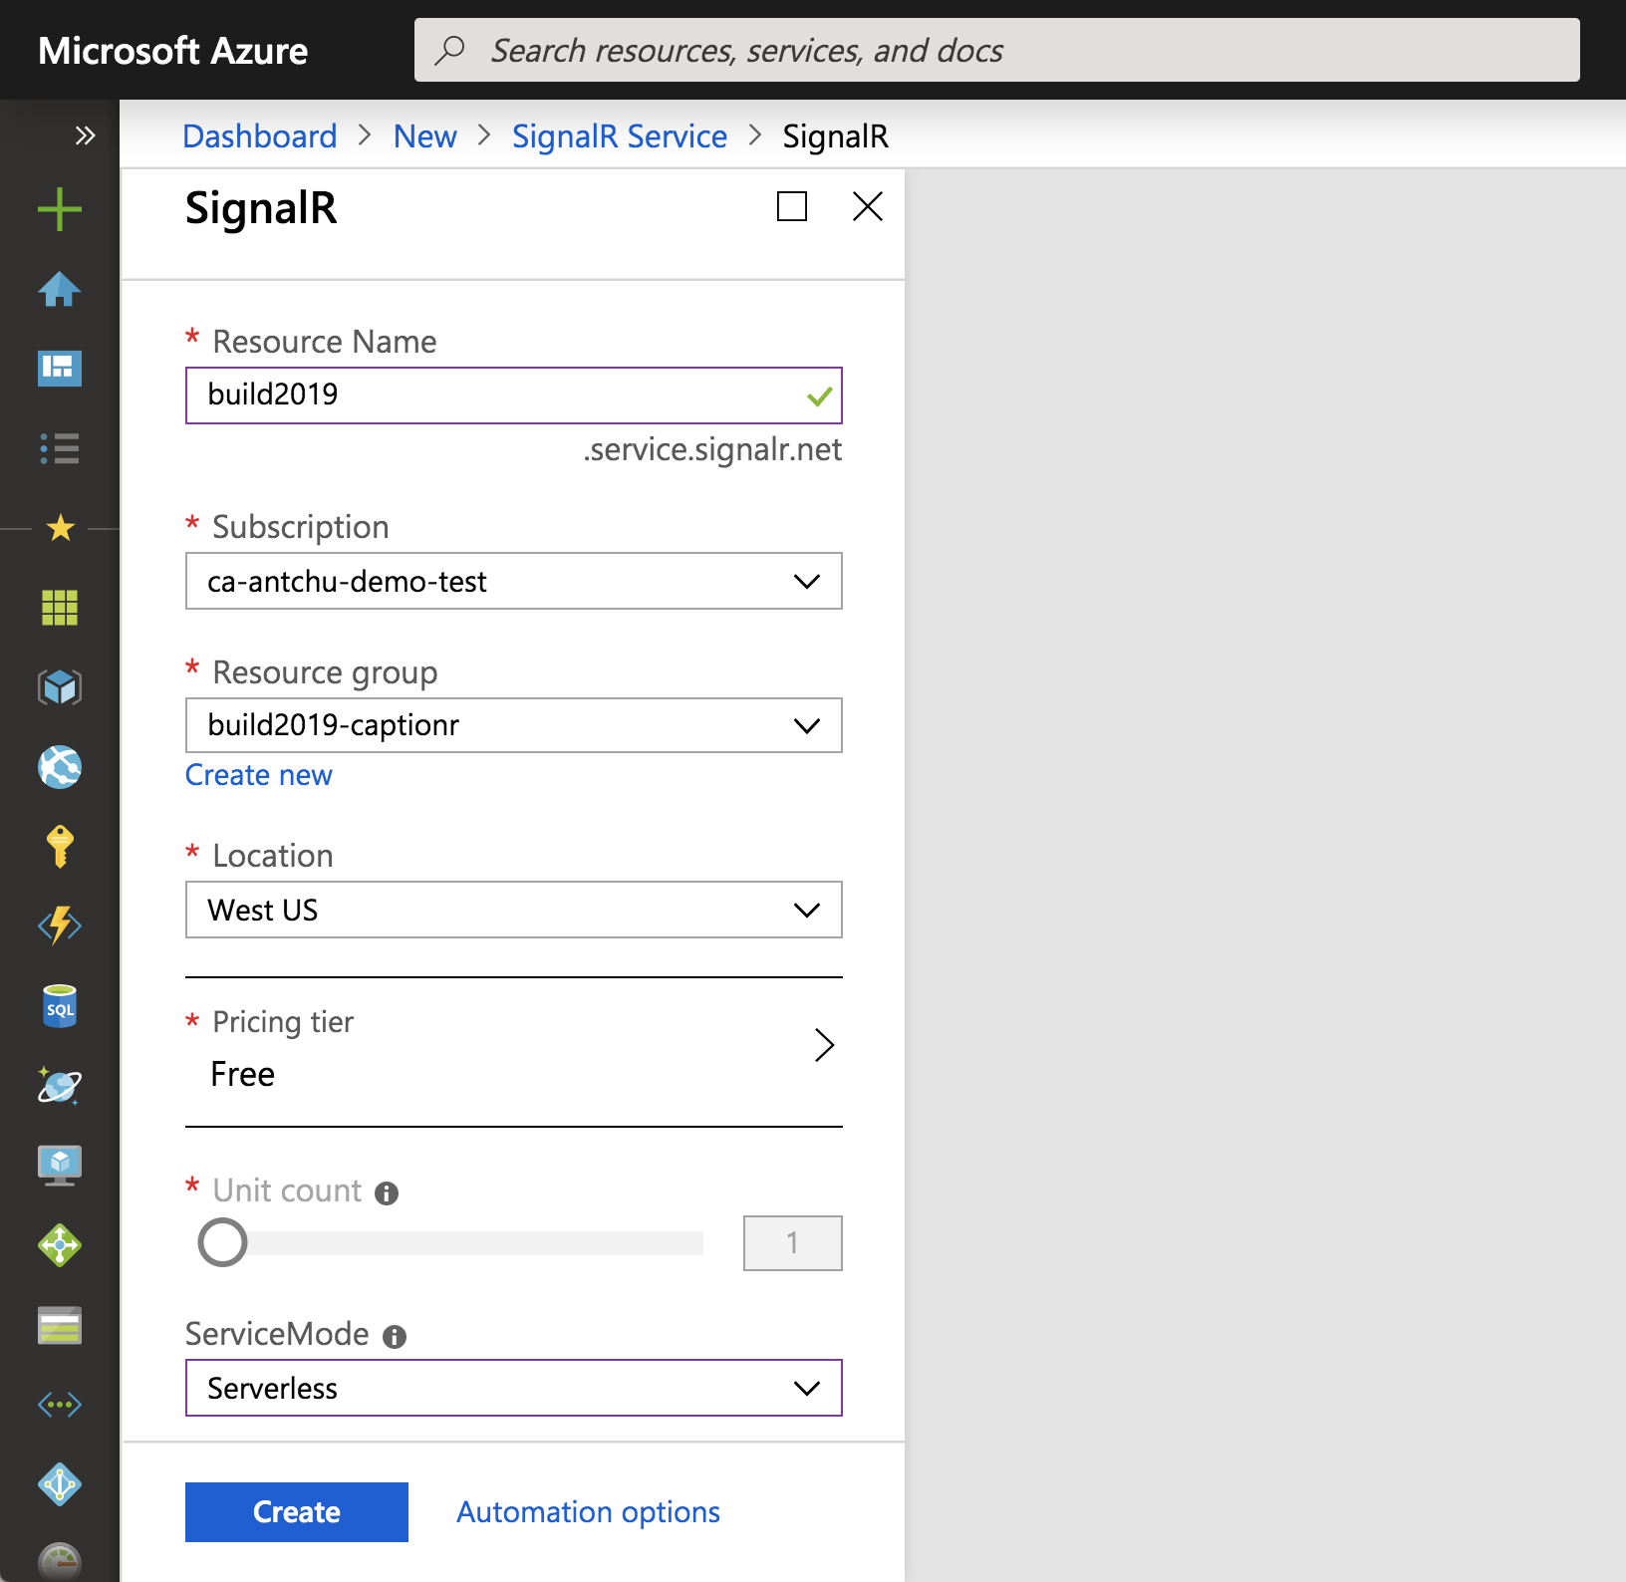
Notes:
It is very easy to get started in azure

Slide 39
Notes:
And you can put it into Serverless mode and there is even a free tier that has up to 20 connections at one time for free for testing.

Slide 40



Broadcast translated captions in real-time
fr
Bonjour
es
Hola
Transcriptions
& Translations
ja
こんにちは
it
Ciao
de
Hallo
Hello
Notes:
So a great scenario here would be creating a real-time caption app that can use Cognitive Services to translate speech and then send it to a function that communicates to SignalR Service that handles everything.

Slide 41
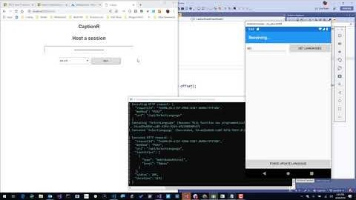

Slide 42
Thank you. Q&A
aka.ms/xamarin
aka.ms/xamarinessentials
github.com/anthonychu/captionr
github.com/jamesmontemagno/xamchat
montemagno.com/real-time-communication-for-mobile-with-signalr/
Name
Title
email
website
@Twitter

